Slide 1



AWS Web Application Firewall (WAF)
Author: Gowtham

Slide 2

CONTENTS
1. What is AWS WAF?
2. Why Do We Need a Web Application Firewall?
3. Key Components of AWS WAF
4. How AWS WAF Works
5. Supported AWS Services
6. Rule Types in AWS WAF
7. Example Use Case
8. Integration with AWS Shield
9. Logging and Monitoring
10. Automation with AWS WAF
11. Pricing Overview
12. Advantages of AWS WAF
13. Real-World Use Cases
14. Summary & Q&A

Slide 3

1. What is AWS WAF?
AWS WAF is a web application firewall that helps protect web applications from common web exploits.
It filters, monitors, and blocks HTTP(S) requests based on user-defined rules.
AWS WAF works with Amazon CloudFront, Application Load Balancer (ALB), and API Gateway.

Slide 4

2. Why Do We Need a Web Application Firewall?
Web applications face threats like:
SQL Injection
Cross-Site Scripting (XSS)
Distributed Denial of Service (DDoS)
WAF helps:
Block malicious traffic
Allow legitimate requests
Reduce downtime and data breaches

Slide 5




3. Key Components of AWS WAF
1
2
Web ACL (Access Control List)
Rules
Defines security rules for filtering traffic.
Each rule specifies a condition (e.g., block SQL injection).
3
4
Rule Groups
Conditions
A collection of reusable rules.
Define criteria like IP address, headers, or query strings.

Slide 6


4. How AWS WAF Works
Incoming web requests go through AWS WAF.
WAF evaluates requests based on Web ACL rules.
Based on conditions, WAF decides to:
Allow
Block
Count

Slide 7




5. Supported AWS Services
AWS WAF can protect:
1
2
Amazon CloudFront (Content Delivery Network)
Application Load Balancer (ALB)
3
4
Amazon API Gateway
AWS AppSync
5
AWS Cognito (for authentication endpoints)

Slide 8


6. Rule Types in AWS WAF
Managed Rules
Custom Rules
Rate-Based Rules
Pre-configured rules by AWS or partners (e.g., AWS Managed Rules for OWASP Top 10).
User-defined rules for specific conditions (e.g., block IP range).
Automatically blocks IPs sending too many requests per second.

Slide 9
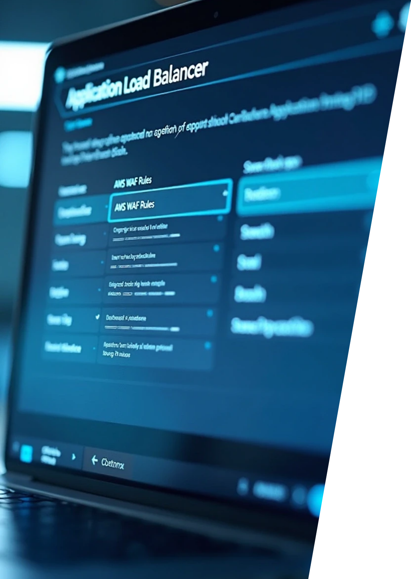


7. Example Use Case
Protect a website hosted on Application Load Balancer.
AWS WAF blocks:
1
SQL injection attempts
2
Suspicious IP addresses
3
Bots and scrapers

Slide 10

8. Integration with AWS Shield
AWS Shield provides DDoS protection at the network and transport layers.
AWS WAF adds application-layer protection.
Combined, they provide complete web security.

Slide 11




9. Logging and Monitoring
AWS WAF logs every request evaluated.
Integration with:
1
Amazon CloudWatch for metrics
2
AWS Kinesis Firehose for log streaming
3
AWS CloudWatch Dashboards for visualization
This enables real-time traffic analysis.

Slide 12


10. Automation with AWS WAF
Automate rule creation using:
AWS Lambda for custom responses
AWS Firewall Manager for centralized rule management across accounts
It supports Terraform and CloudFormation for Infrastructure as Code (IaC).

Slide 13

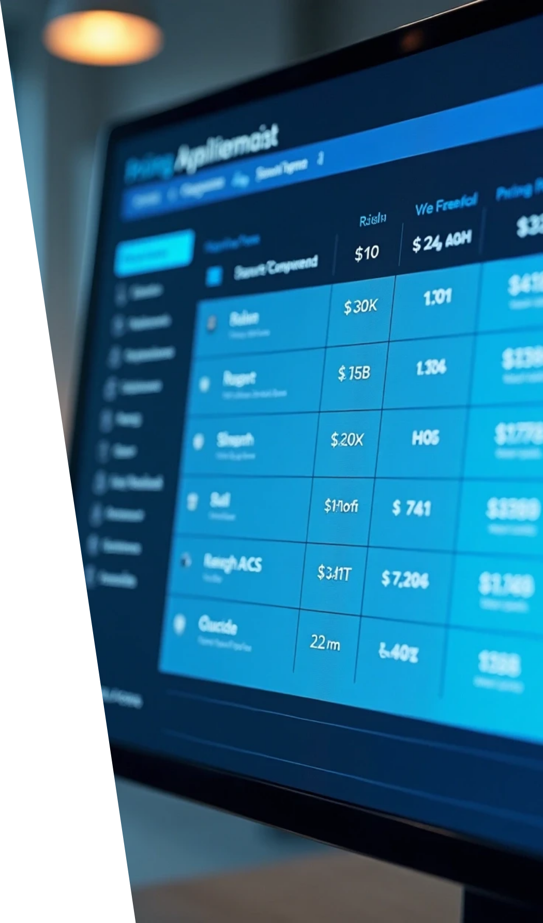


11. Pricing Overview
Pay only for what you use:
1
Number of Web ACLs
2
Number of Rules per ACL
3
Requests processed by WAF
Example:
1
$5 per Web ACL per month
2
$1 per rule per month
3
$0.60 per million requests

Slide 14
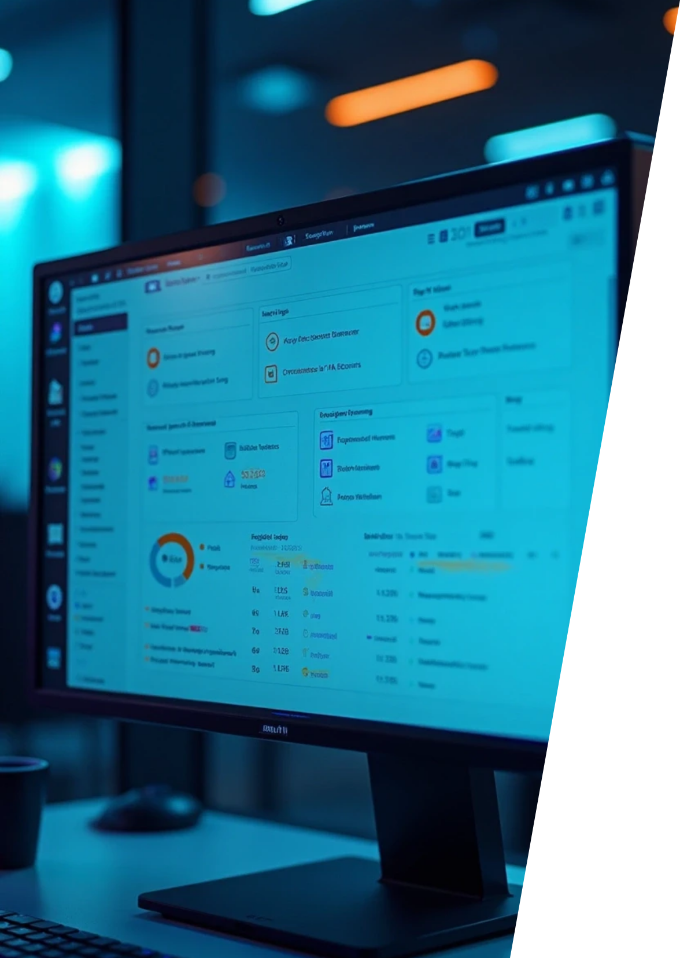


12. Advantages of AWS WAF
🛡️ Protects against common web exploits (OWASP Top 10)
⚙️ Fully managed and easy to deploy
📈 Scales automatically with application traffic
🔄 Customizable rule sets
💰 Pay-as-you-go pricing

Slide 15





13. Real-World Use Cases
1
2
3
Protecting e-commerce websites from bot attacks
Preventing SQL injection and XSS on public APIs
Rate-limiting brute-force login attempts
4
5
Securing web apps hosted on CloudFront or ALB
Meeting compliance and audit requirements

Slide 16

14. Summary & Q&A
Summary:
AWS WAF is a powerful, managed web application firewall service.
It protects web applications from common attacks.
Works with CloudFront, ALB, API Gateway, and integrates with AWS Shield for enhanced protection.
Thank You!
Questions? 💬

Slide 17
Thank You

